Slide 1
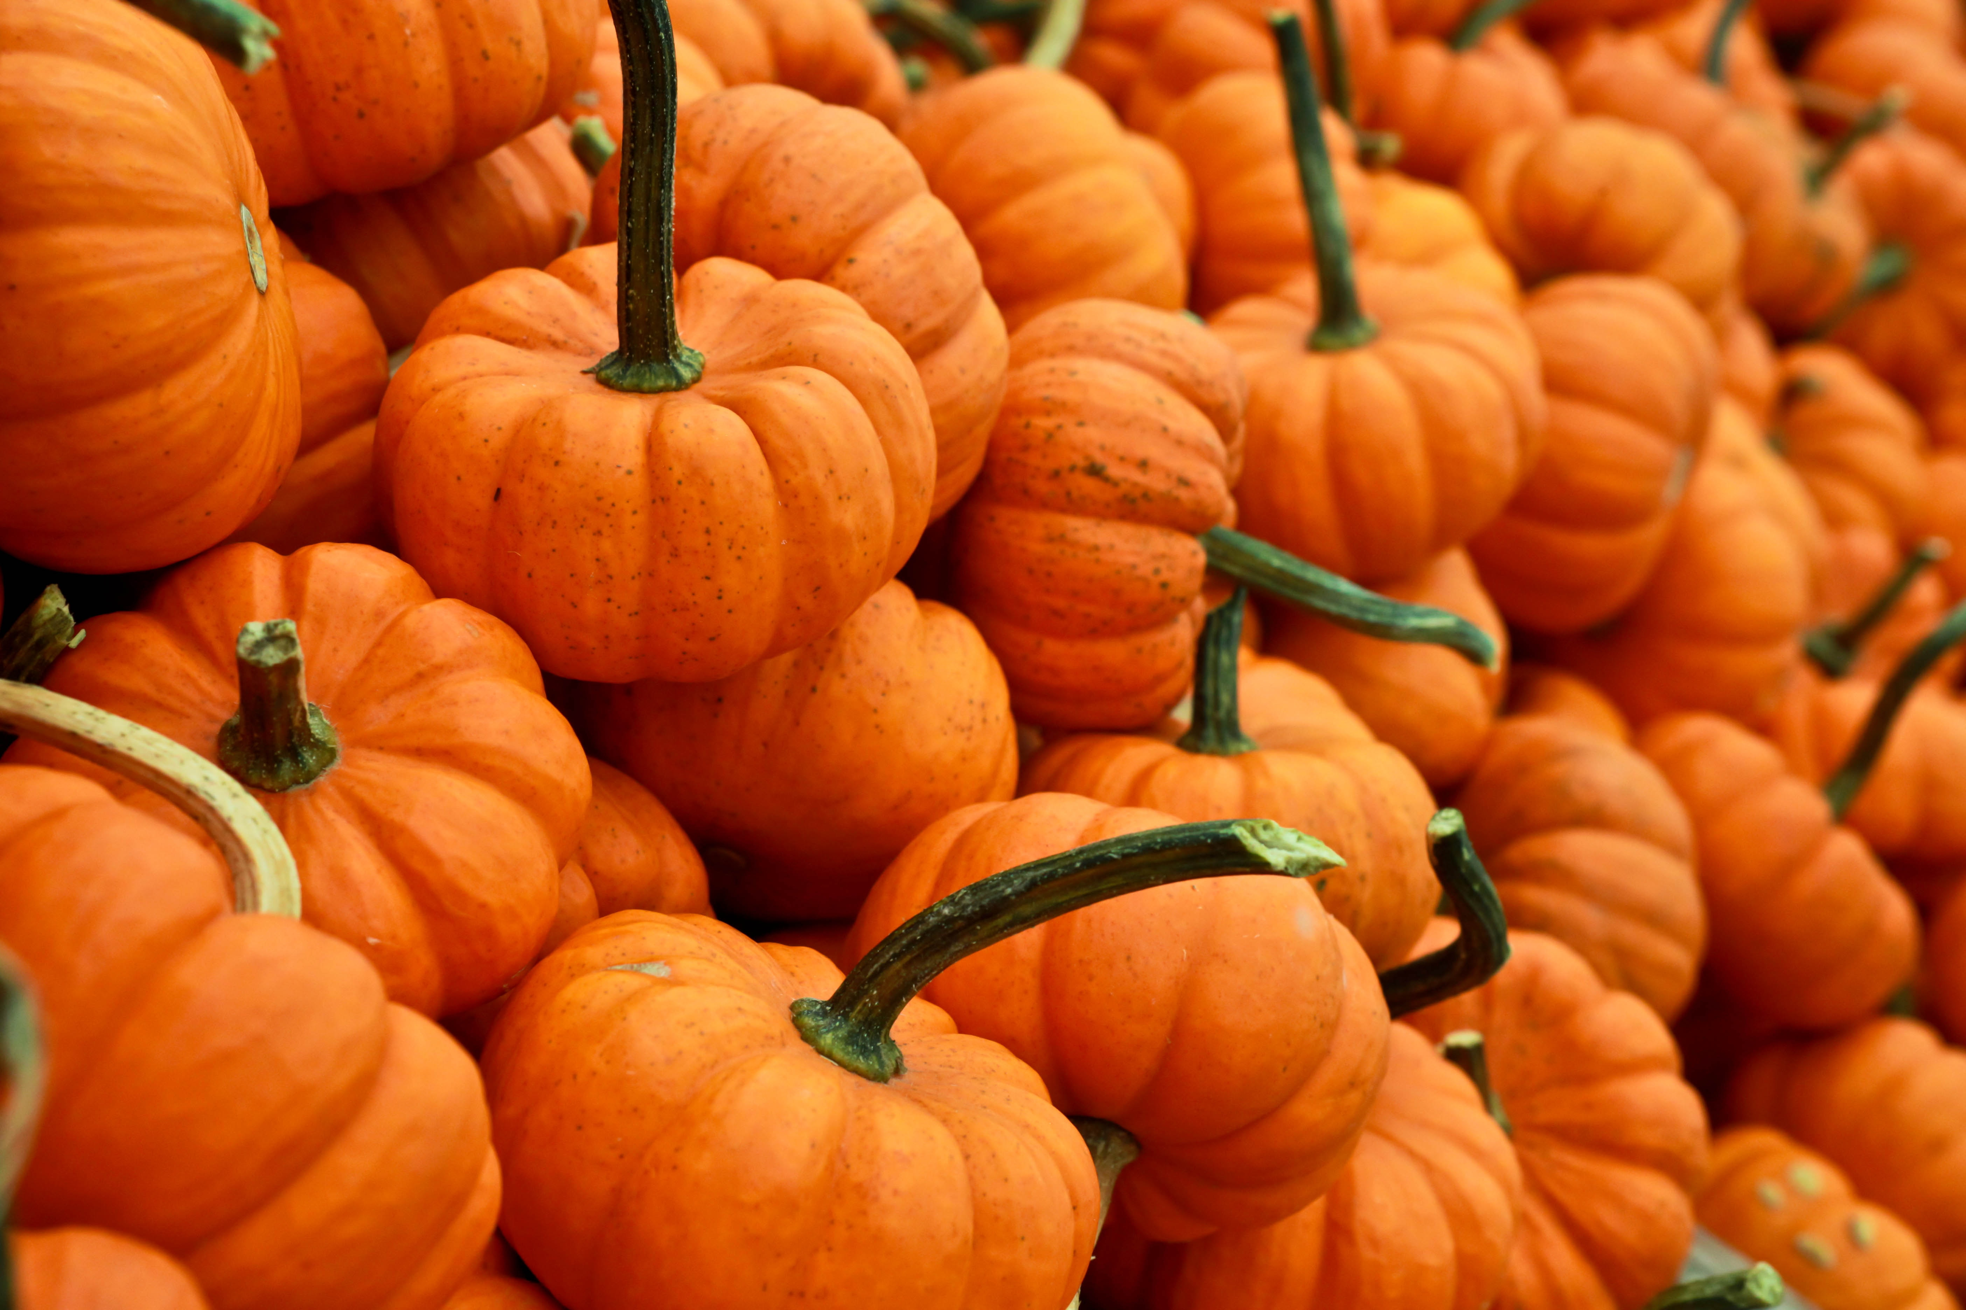
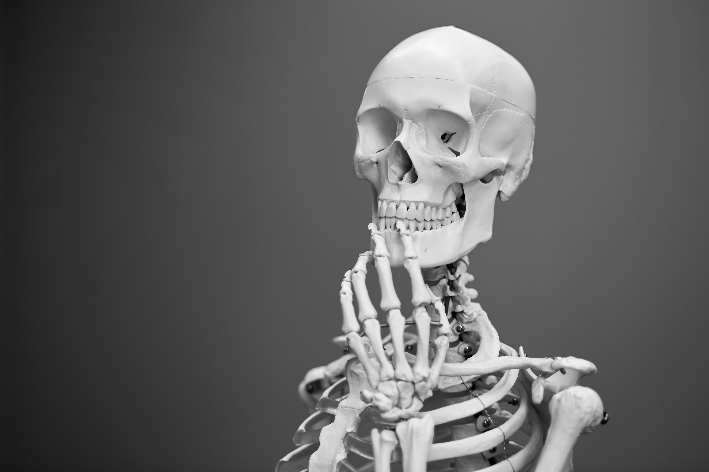
Analyzing haunted places using R
A Library Trick {R} Treat

Slide 2

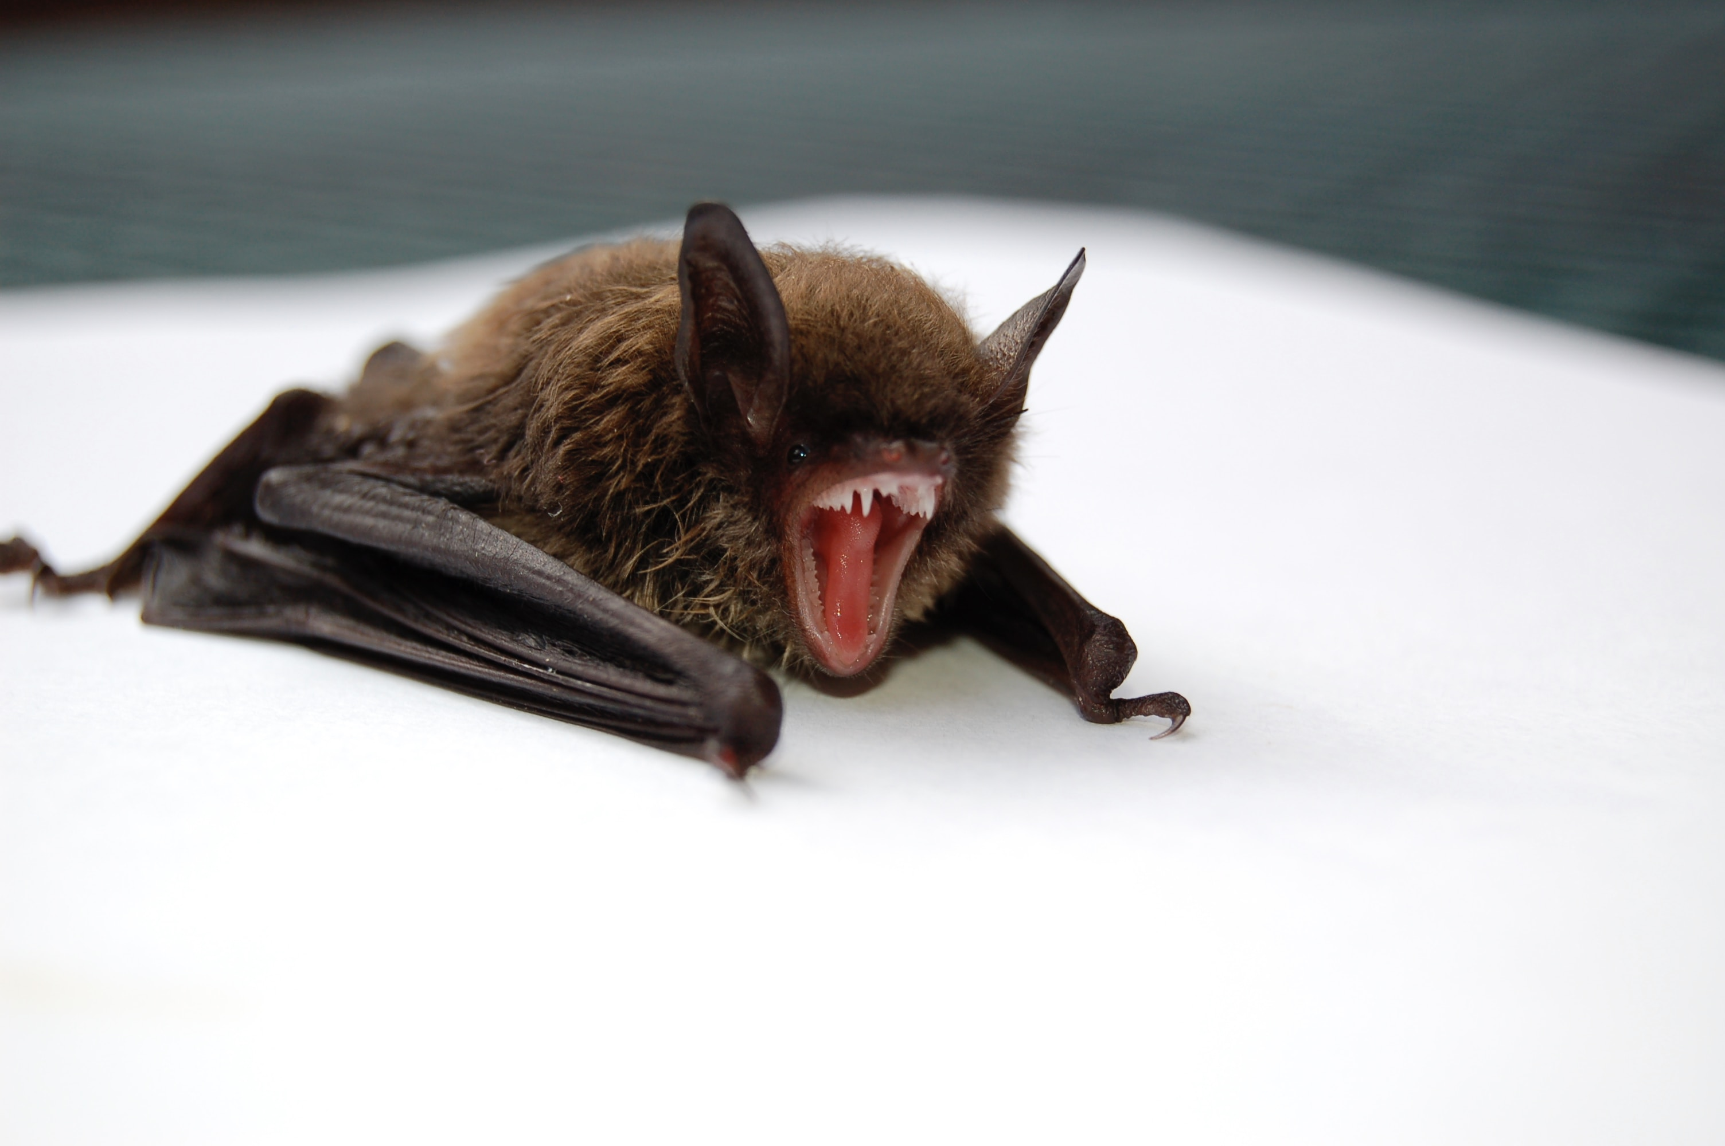
Session structure
Slides
Demo
Aggregation
Data visualization
Data cleaning
Text analysis
Design or conduct your own analysis

Slide 3
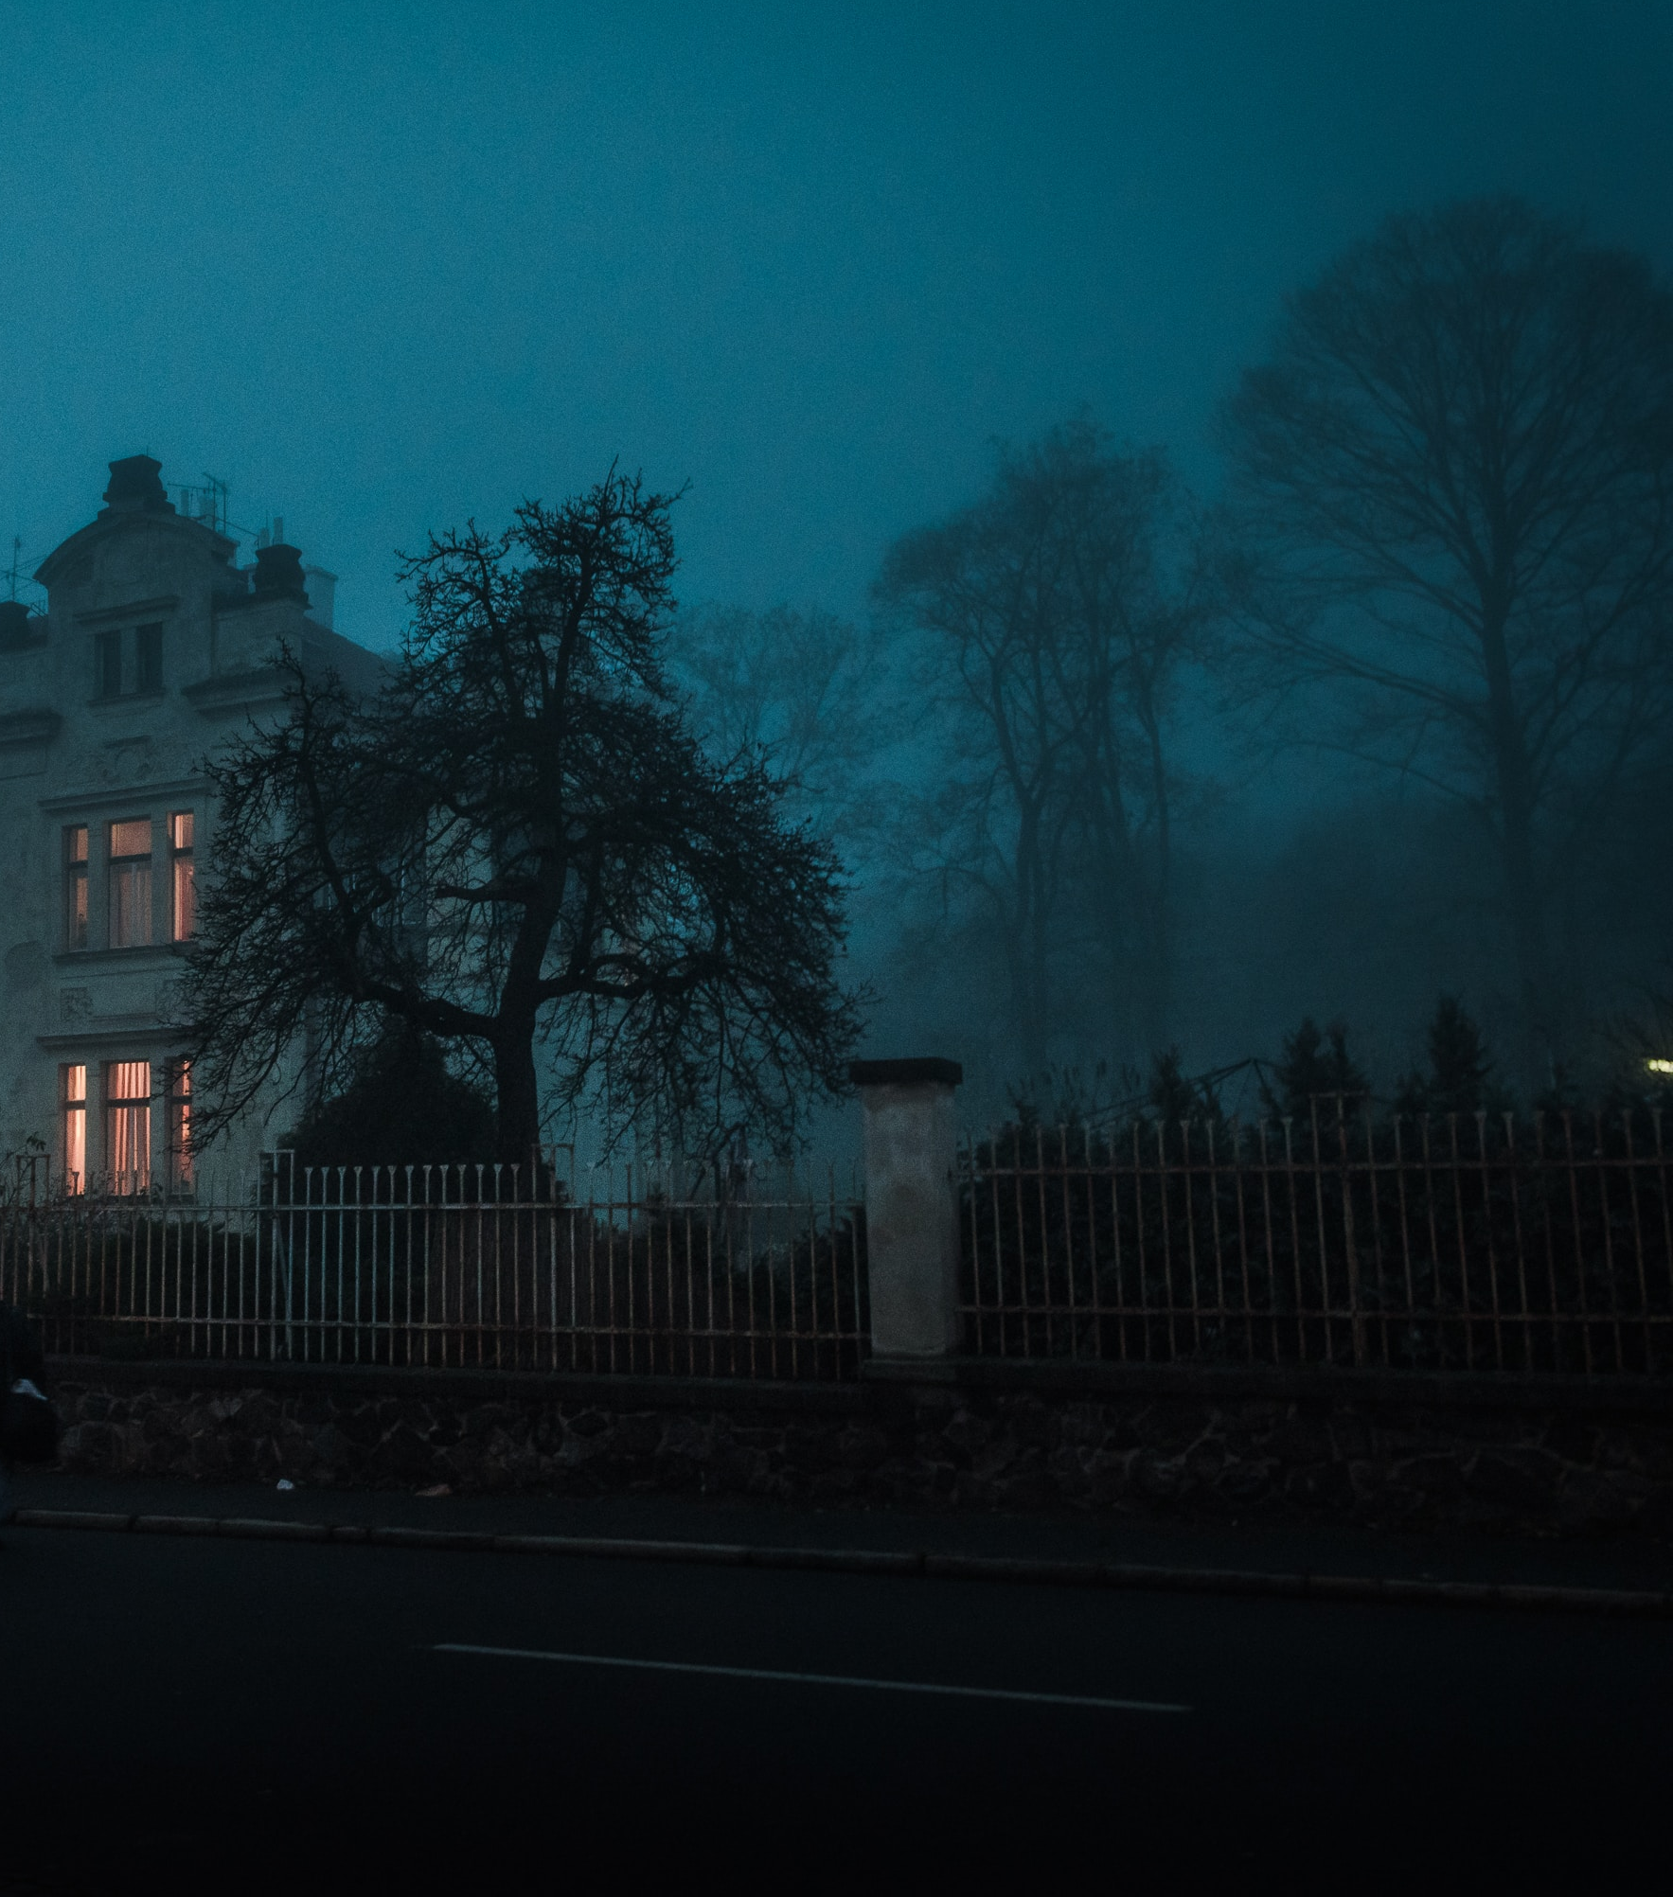

Haunted Locations Data
The Shadowlands Haunted Places index: http://www.theshadowlands.net/places/
Data collection method: crowd sourcing
Data access point: https://data.world/timothyrenner/haunted-places
Data extraction methods and cleaning methods: https://github.com/timothyrenner/shadowlands-haunted-places

Slide 4
Analysis design exercise
What other data cleaning opportunities do you see in this dataset?
Which states seem have the most violent hauntings?
What are common words that appear in the Walmart hauntings?
What are the most haunted cities within a particular state?
Which state has the most haunted universities?
Or, develop your own research question

Slide 5
Which states seem to have the most violent hauntings?
Identify how you will qualify violence
Quantify the occurrence of violence
Is violence a binary or scaled?
Determine the level of aggregation you would like to perform
Are you analyzing violence per location, per state, or per region of the country?

